Slide 1
My Site & Vs Code Macro
발표자 2017314380 윤성경

Slide 2
INDEX
My Site
Introduce HTML | CSS
[Structure] | [Style]
Introduce Javascript | JQuery
[Logic]
HTML + MarkDown
Vs Code Macro
When we need this Macro?
How to use it?

Slide 3
Introduce HTML | CSS
HTML is Hyper Text Markup Language
And used for making Structure of Site
This is basis of Site
CSS is Cascading Style Sheet
And used for giving Styles to each Element
This is look of the Site

Slide 4
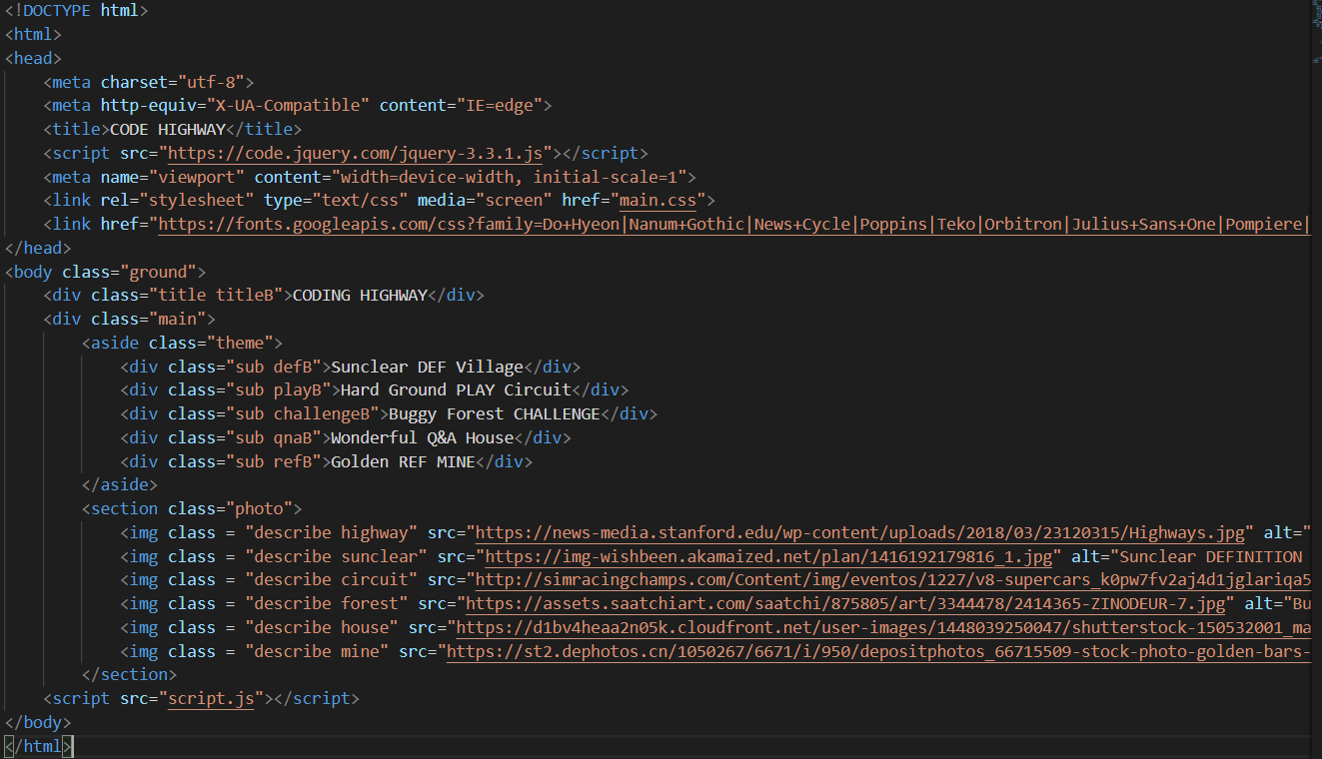
[Structure] – my code

Slide 5
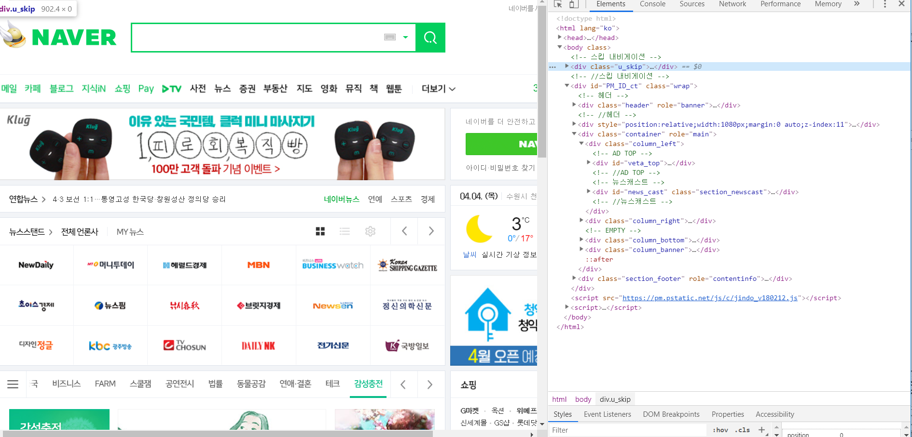
[Structure] – naver example

Slide 6
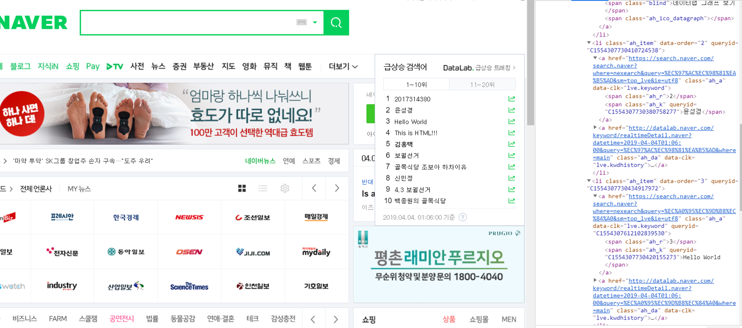
[Structure] – access html

Slide 7
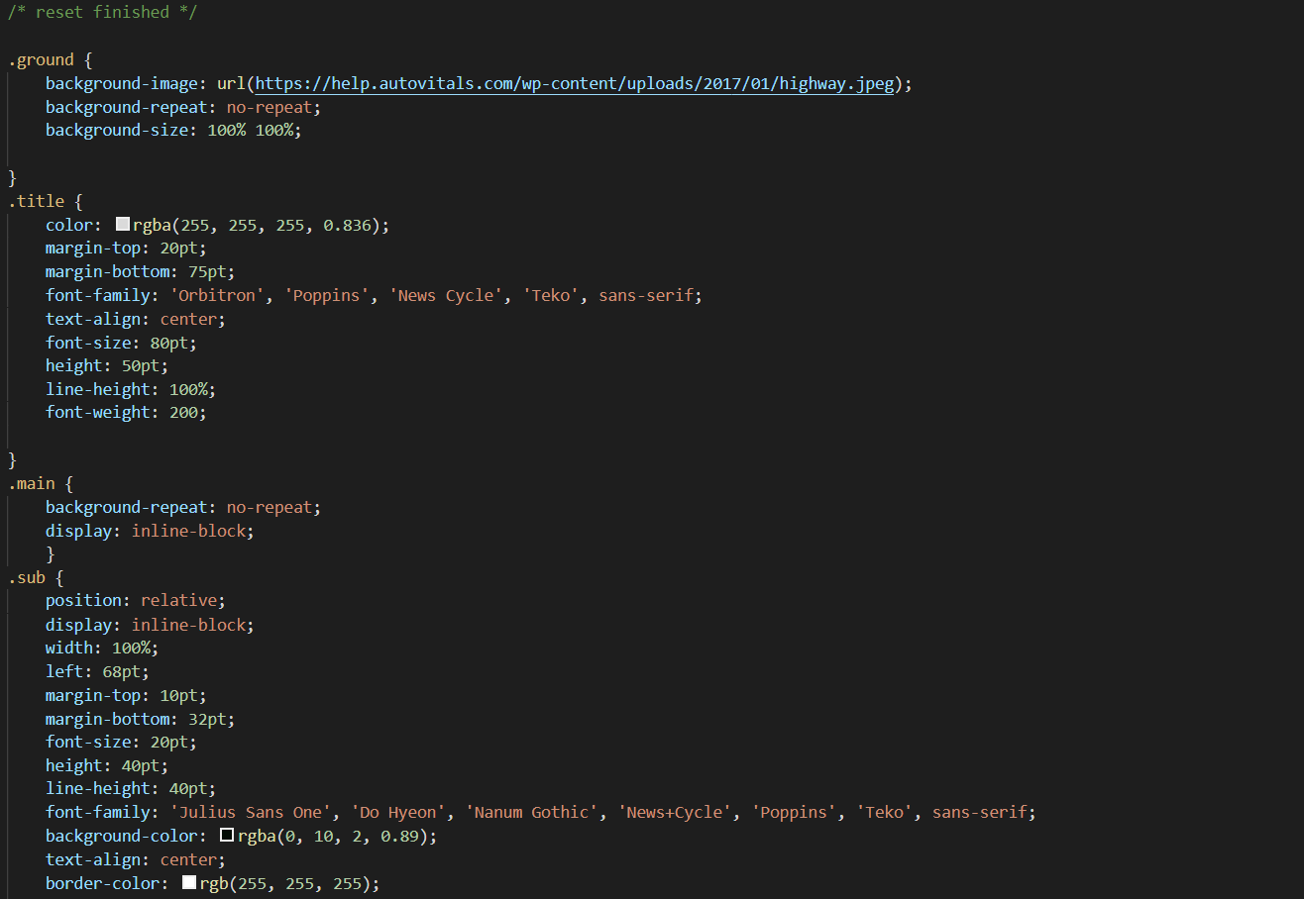
[Style] – my code

Slide 8
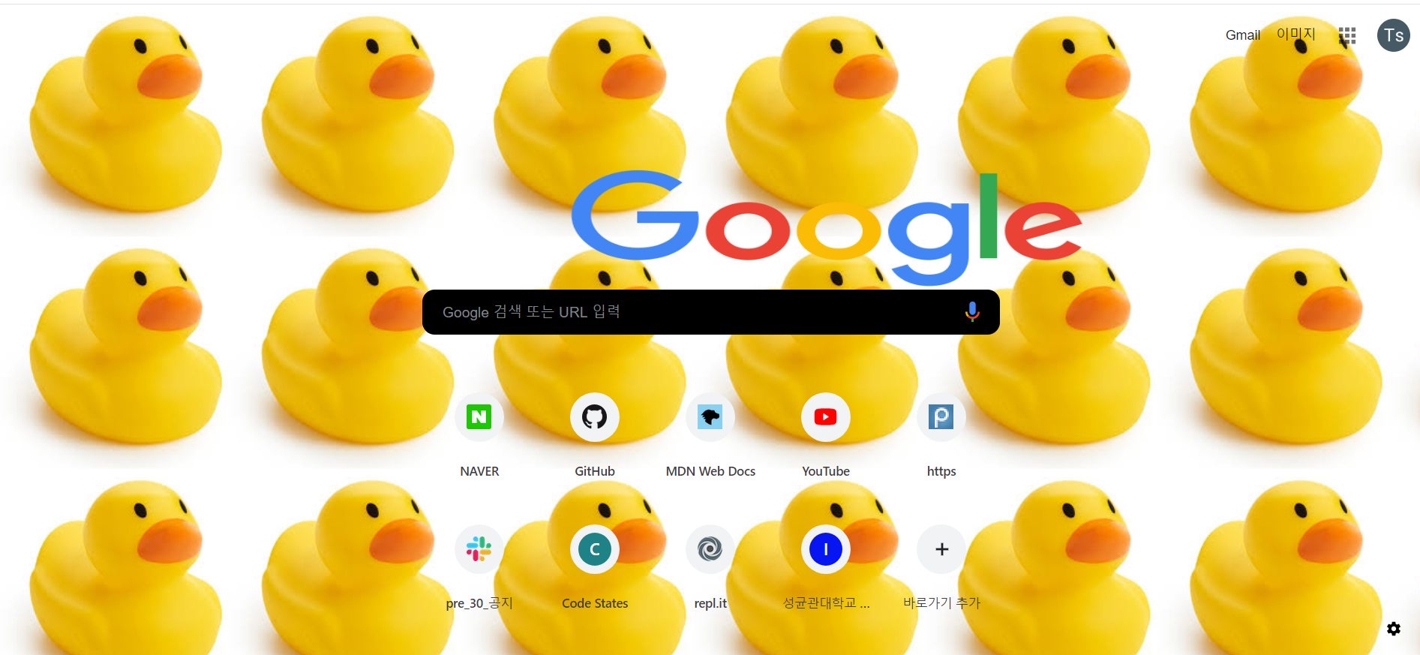
[Style] – Google example

Slide 9
Introduce Javascript | JQuery
Javascript is a special language for providing dynamic web service
And used for making Logic of Site.
This is Main engine of the Site
JQuery is the Powerful tool to use the Web Object in javascript

Slide 10
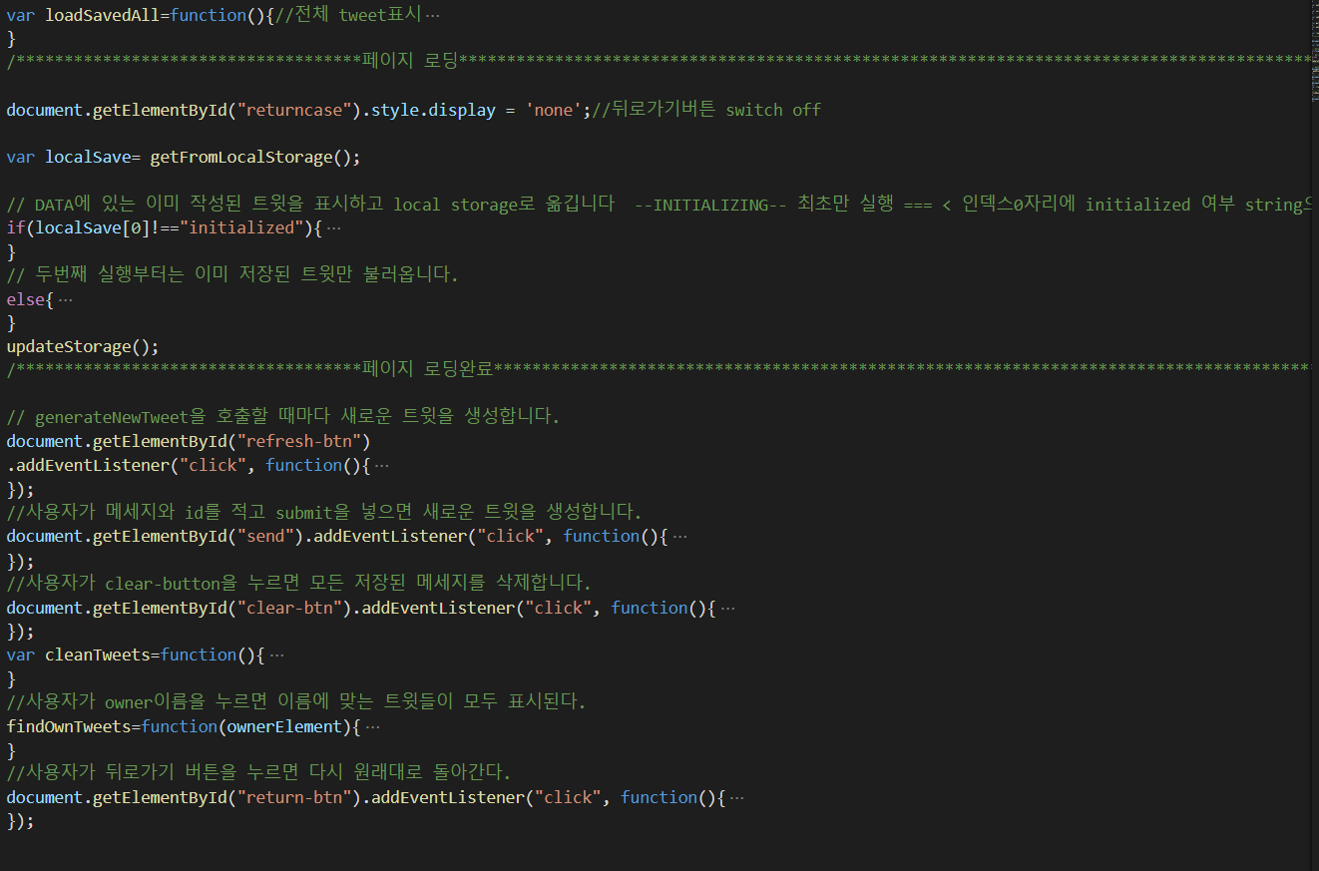
[Logic] – my code

Slide 11
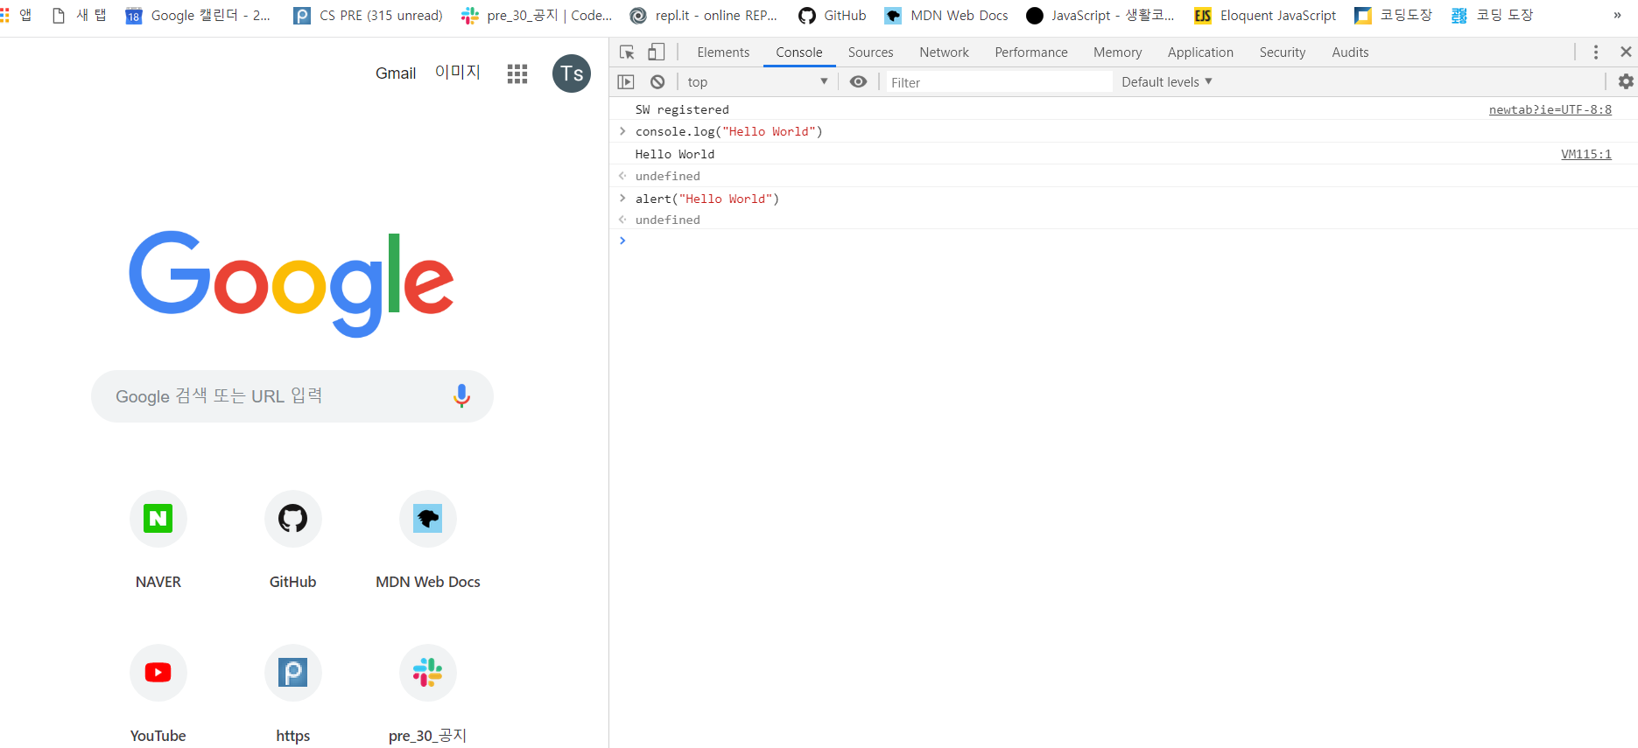
[Logic] – google

Slide 12
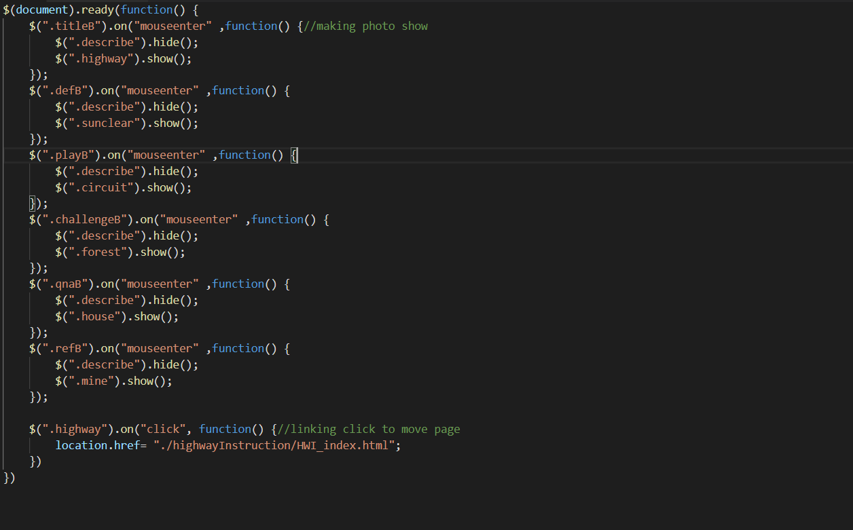
[Logic] – code with JQuery

Slide 13
HTML + MarkDown
You can use the MarkDown to build your site easily
First write text with MarkDown and convert it to HTML
(MarkDown is created to be converted to HTML)
Put the HTML codes to place they fit

Slide 14
Reference to start
HTML/CSS (full cover) *****
https://learn.shayhowe.com/
HTML/CSS/Javascript/Jquery (quick start) ****
https://www.w3schools.com/
Javascript (quick start) ****
https://opentutorials.org/course/743
Javascript (complete book) *****
https://eloquentjavascript.net/
Reference Site
Google
Naver
Coupang
…

Slide 15
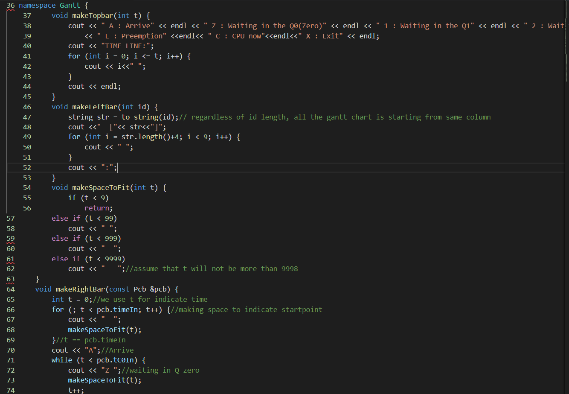
When we need this Macro?

Slide 16
When we need this Macro?
Refactoring
Quick fix
Structure fix
Fast, Safe, Efficient coding

Slide 17
How to use it?
Ctrl + / = comment
Shift + ctrl + alt + [pg]up / [pg]down = multicursor
Alt + click = multicursor
Shift + Tab = deindent
Right-click + <change all occurrence>
Shift + Alt + F = auto-format

Slide 18
Reference to start
Reference Site
https://dev.to/codevault/multi-cursor---visual-studio-code-productivity-features---part-1-1gha
https://code.visualstudio.com/docs/getstarted/tips-and-tricks
(here shows all the macro preset & how to set your own macro)

Slide 19
Thank you !
Now you can do it
yourself!

